Slide 1
Theatre and science: a new way to teach and learn integrating different competence areas.
Scuola secondaria di 1° grado “C. Guastella” Misilmeri (Pa)
Plesso “PORTELLA DI MARE”
M. Gloria Calì
2 /4/2014

Slide 2
Science
Italian
Theatre

Slide 3
The process of creating the “didactic object”
Textual production
A scientific subject
A group of student
The scientific comedy

Slide 4
2011: “Medici in primo piano”
The two great ancient physicians, Hyppocrates and Galenus, argue in an impossible talk-show: who is the most important pioneer for modern medicine? Only the God Asclepius will keep everything in the right order…

Slide 5
2012: “PseudoPitagora”
A day in the school of the great philosopher Pytagoras, learning about geometry, biology, and… respect for teachers.

Slide 6
2013: “Il Mangiapaesaggi”
A mistery upset Punic ancient towns in Sicily: pieces of landscape disappear without reasons. Two detectives will find the solution: an unexpected wrong use of technology.

Slide 7
This year… the subject is the mathematical probability.
“Certo e probabile”
Human behaviour
Mathematic theory

Slide 8
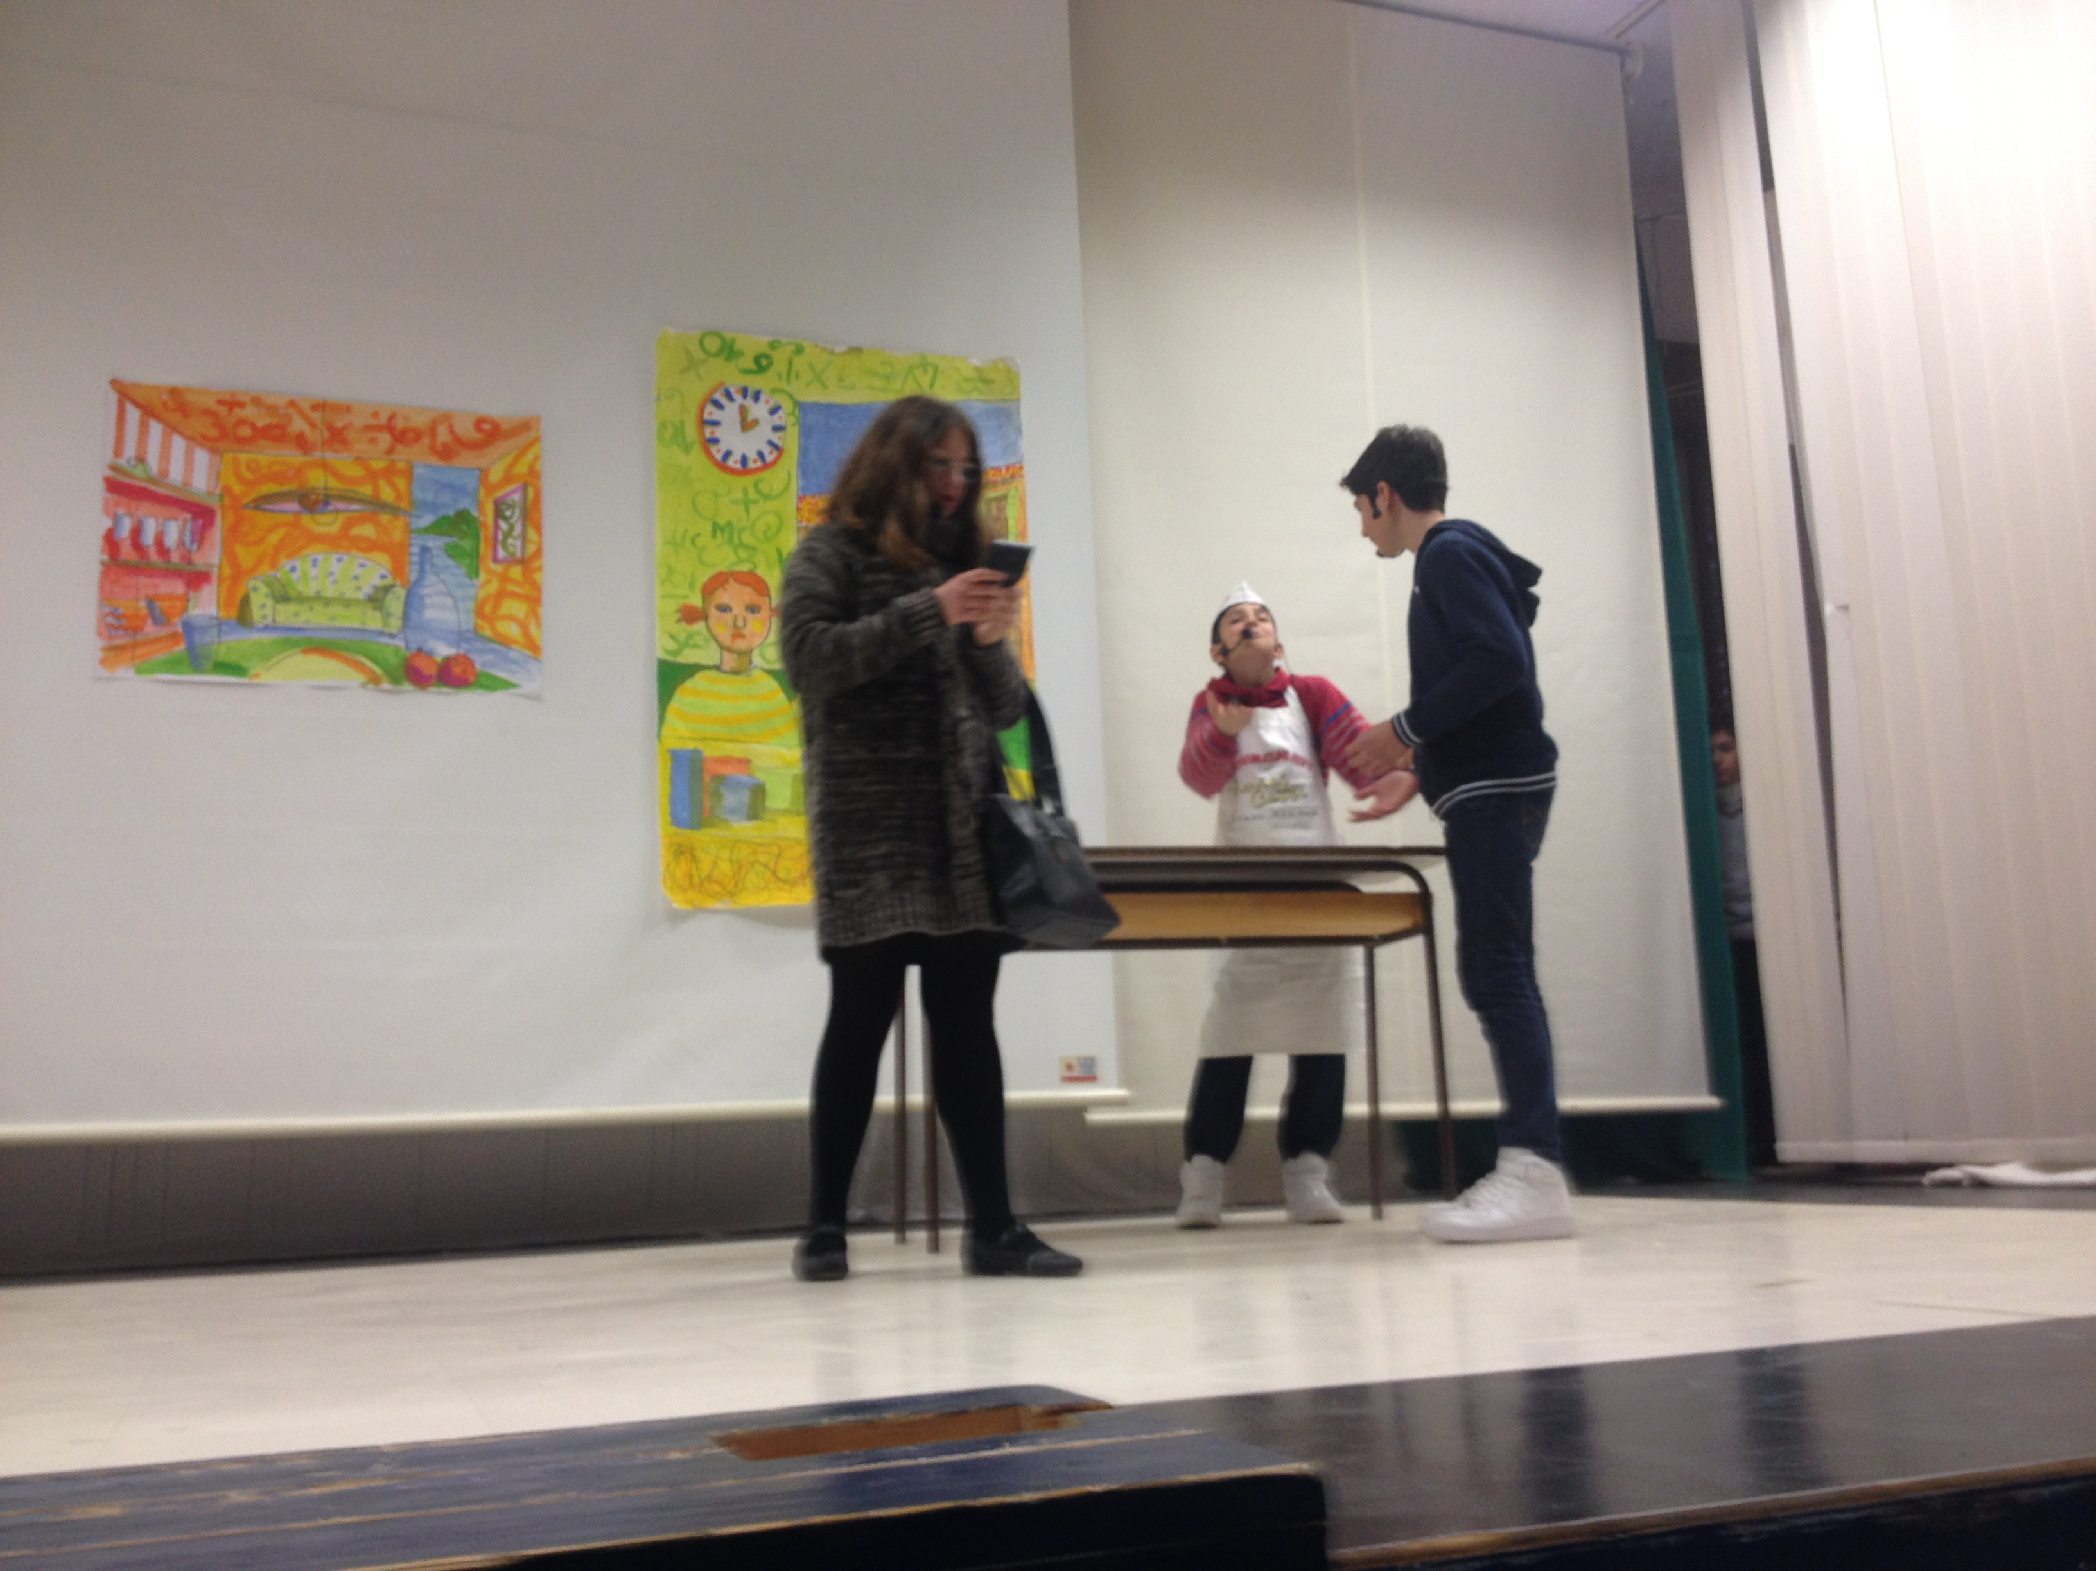
Chiara Certo and Fortunato Probabile have different ways of life: she’s sharp and anxious, he’s loose and messy.

Slide 9
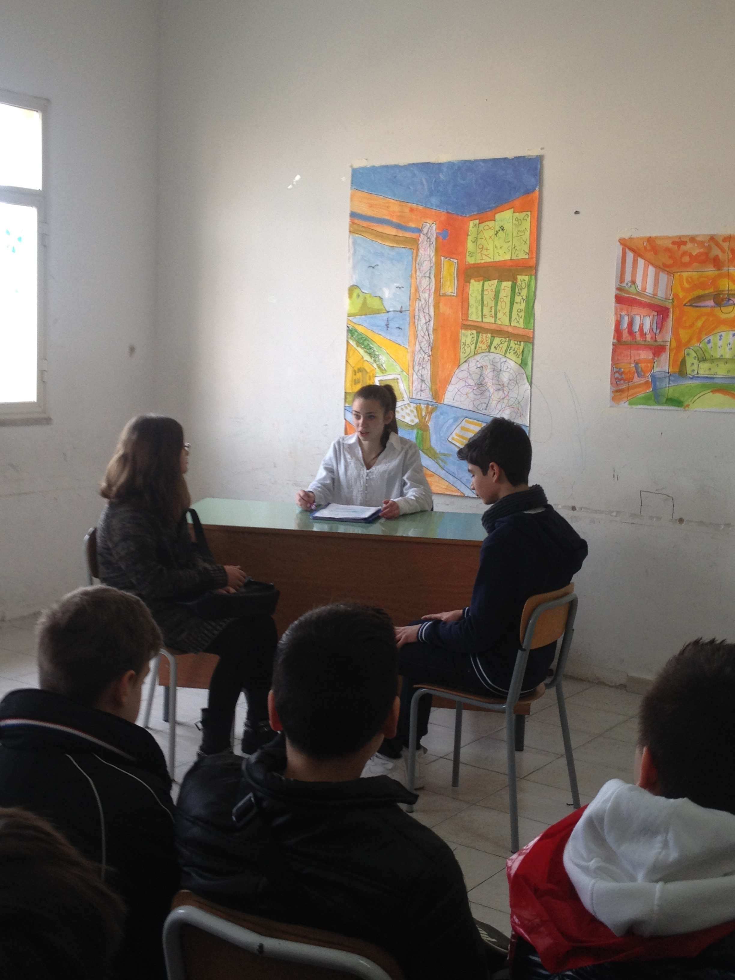
They meet and argue in different situations… at work, for example.

Slide 10
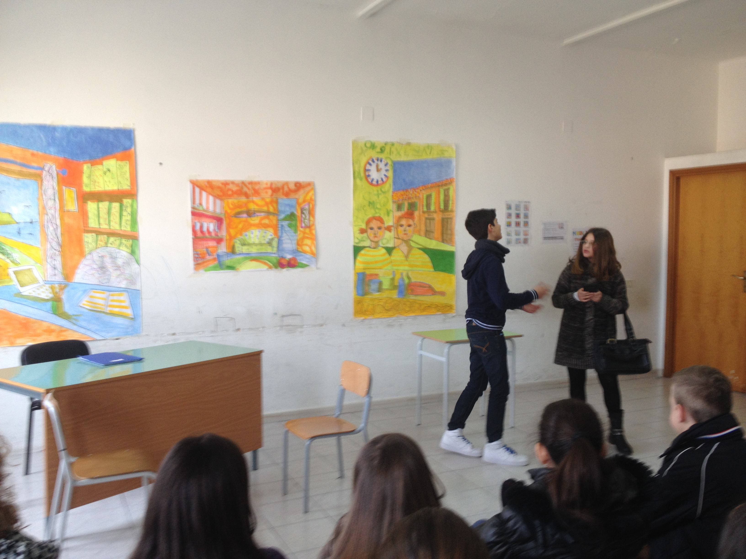
It seems impossible to live together…

Slide 11
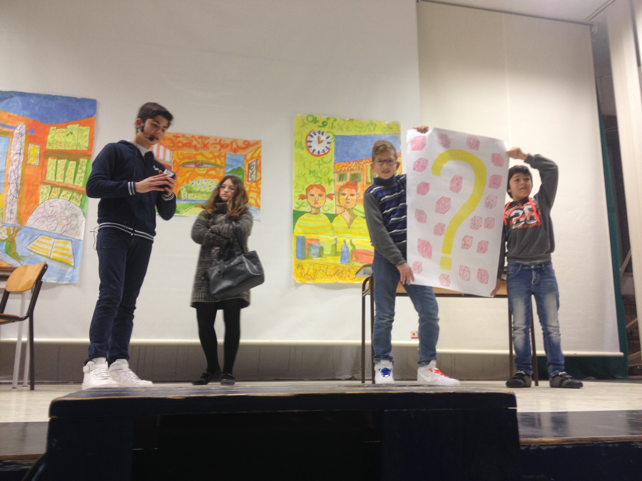
But their difference is richness, and, thanks to the maths and to their good temper, they realise that they have to improve the best parts of themselves and reduce the worst.

Slide 12
WHAT DID WE GET IN PERFORMING SCIENCE IN A THEATRE?
We got competence in both areas, science and italian…
We worked together…
We learnt in a cooperative setting…
We are more responsible about our awareness and abilities…
We enjoyed ourselves!

Slide 13
Grazie e … arrivederci!
M. Gloria Calì
cali.mgloria@gmail.com

